Slide 1
Online Poker Game
Calvin Besch, Cody De La Fleur, Jason Mcgee, Sam Ongstad

Slide 2
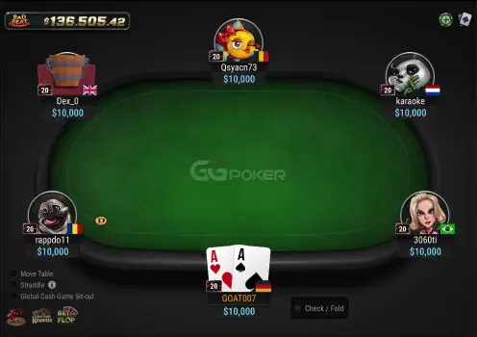
User Requirements
Working online poker site
Free to play
Friends could connect to games from their system
No need to login or create an account
Easy to use and open source
Just go to the website and play

Slide 3
Our Project Goals
Online Poker Game hosted on a website
Currently locally hosted
Built to play Texas Holdem
Users are given fake money to bet with resetting each round
Each game can host up to 6 players
First player to join the game is designated as the host of the game

Slide 4


Breaking up the Project
Broken up into four main parts
UI
Backend logic
Connecting UI and backend
Creating server/client functionality
All parts of the project were coded in Javascript
Frontend in React.js, CSS and HTML
Backend in Node.js and Express.js
Network uses Cors

Slide 5
Project Architecture
Browser
Server
GUI
Pretty Pictures
Cards
Buttons
Subscribes to server
state changes
“Server”
HTTP Endpoints
/call
/raise
/fold
The games live
here
Game Logic
Actual game
Methods
call()
raise()
fold()
Game state
“Hey player A in game B wants to call”
“Hey do the call”
“Has player X taken their turn yet? How about now?
“You lost all your money”

Slide 6

Demo

Slide 7
Roadblocks We Ran Into
Members of our group were forced to wait for other parts to be complete
Connecting the UI and Logic required both to be finished before work could get done
Server/Client connection requires all previous parts to be done
Sometimes we had to backtrack progress as well
The backend was built to take in input from the terminal window
Best way to test the Logic.js file to make sure it works properly, but not compatible with UI
We all had to learn javascript
We’re coding professionals (minus Cody) but learning a new language still takes time
Each time we need something new done, we’d have to research that too

Slide 8
Whats next?
Bugfix
Deal with edge cases
any user attempting to break the game
Fix folding and add a check button
Handle showdowns
make it so cards flip over after game ends instead of just giving the winner money and starting new hand
Improve design
Move the seats to proper (better) locations
Move around components/change color schemes
Fix the font, and location of text (for money and turn declaration)

Slide 9
Thanks For Listening
Any questions?

